Slide 1
CS3205 – HCI in Software Development Design Principles
Dr. Mark Floryan
Rice Hall 203
mrf8t@cs.virginia.edu
Adapted From:
“Lecture materials by Saul Greenberg, University of Calgary, AB, Canada. http://saul.cpsc.ucalgary.ca/saul/pmwiki.php/HCIResources/HCILectures”

Slide 2
Nine Principles of Design
Simple and natural dialog
Speak the user’s language
Minimize user’s memory load
Be consistent
Provide feedback
Provide clearly marked exits
Provide shortcuts
Deal with errors in a positive manner
Provide help

Slide 3
Design principles
Broad usability statements that guide a developer’s design efforts
use the users language
provide feedback…
Derived from common design problems across many systems
i.e., These principles are NOT random. They have been observed over many systems, many years of research, etc. They are derived from very common usability issues.

Slide 4
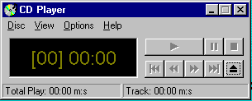
1: Simple and natural dialogue
use the user’s conceptual model
match the users’ task sequence
minimize mapping between interface and task semantics
Does NOT mean make the interface simple.
Means to make the “dialogue” simple. How the user thinks of it.
Simple Dialogue, matches physical music player.
From Microsoft applications

Slide 5
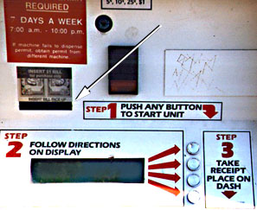
1: Simple and natural dialogue
Buying a parking lot permit
What is the conceptual model here? Why is this confusing?

Slide 6
1: Simple and natural dialogue
Present exactly the information the user needs
less is more
less to learn, to get wrong, to distract...
information should appear in natural order
related information is graphically clustered
order of accessing information matches user’s expectations
remove or hide irrelevant or rarely needed information
competes with important information on screen
remove modes
use windows frugally
don’t add unneeded navigation and window management

Slide 7
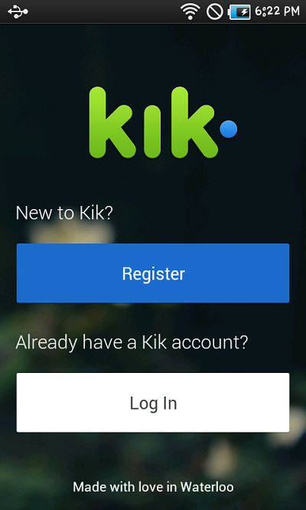
1: Simple and natural dialogue
Watch what happens when I try to register for this app.
Show on phone->

Slide 8
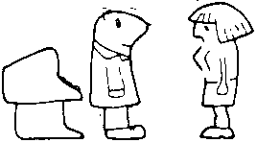
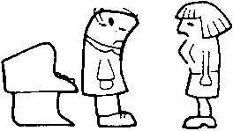
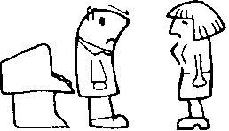
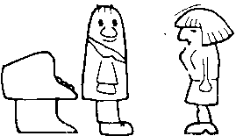
2: Speak the users’ language
My program gave me the message Rstrd Info. What does it mean?
That’s restricted information
But surely you can tell me!!!
No, no… Rsdrd Info stands for “Restricted Information”
Hmm… but what does it mean???
It means the program is too busy to let you log on
Ok, I’ll take a coffee

Slide 9
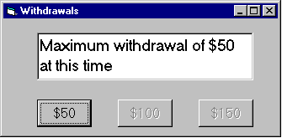
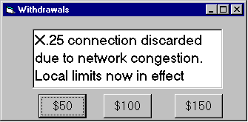
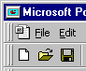
2: Speak the users’ language
Terminology based on users’ language for task
e.g. withdrawing money from a bank machine
Use meaningful mnemonics, icons & abbreviations
eg File / Save
Ctrl + S (abbreviation)
Alt FS (mnemonic for menu action)
(tooltip icon)

Slide 10
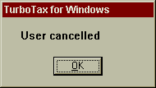
2: Speak the users’ language

Slide 11
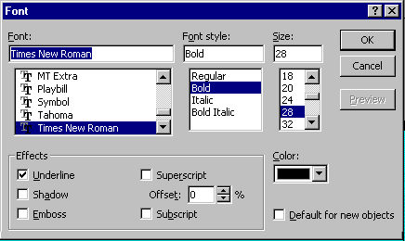
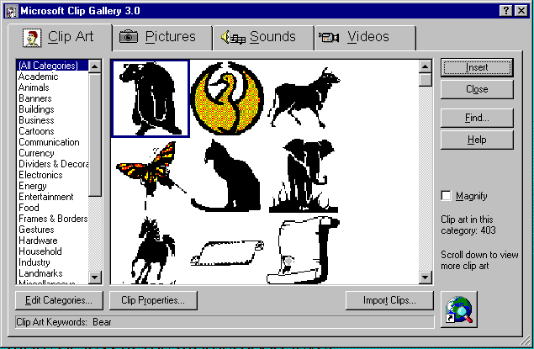
3: Minimize user’s memory load
Computers good at remembering, people are not!
Promote recognition over recall
menus, icons, choice dialog boxes vs commands, field formats
relies on visibility of objects to the user (but less is more!)
From Microsoft applications

Slide 12
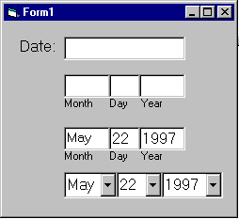
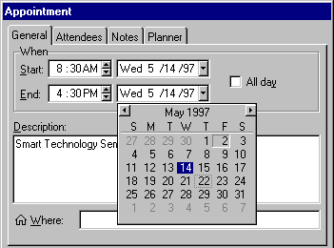
3: Minimize user’s memory load
Gives input format, example and default

Slide 13
3: Minimize user’s memory load
Small number of rules applied universally
generic commands
same command can be applied to all interface objects
interpreted in context of interface object
copy, cut, paste, drag ’n drop, ... for characters, words, paragraphs, circles, files
context menus

Slide 14
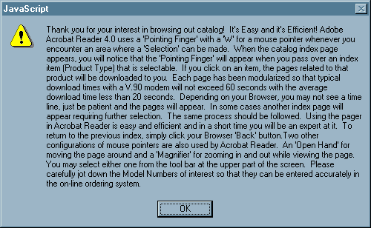
3: Minimize user’s memory load

Slide 15
4: Be consistent
Consistent syntax of input
Consist language and graphics
same visual appearance across the system (e.g. widgets)
same information/controls in same location on all windows
Consist effects
commands, actions have same effect in equivalent situations
predictability
Ok
Cancel
Cancel
Ok
Ok
Accept
Dismiss
Cancel

Slide 16
4: Be consistent

Slide 17
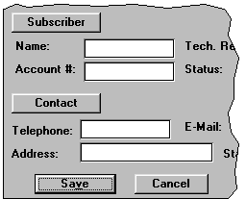
4. Be Consistent
These are labels with a raised appearance.
Is it any surprise that people try and click on them?

Slide 18
4. Be Consistent
Internal Consistency:
- Consistency within your application.
External Consistency:
- Consistency with applications similar to yours.

Slide 19
Interesting!
http://www.theatlanticcities.com/design/2013/09/brillliant-idea-keep-escalator-obstructers-right/6912/

Slide 20
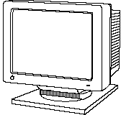
5: Provide feedback
Continuously inform the user about
what it is doing
how it is interpreting the user’s input
user should always be aware of what is going on
What’s it doing?
Time for coffee.
> Doit
> Doit
This will take 5 minutes...

Slide 21
5. Provide feedback
What mode am I in now?
What did I select?
How is the system interpreting my actions?
Microsoft Paint

Slide 22
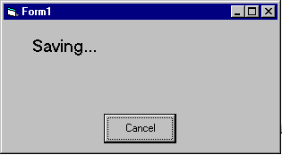
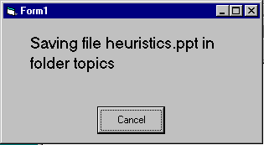
5. Provide feedback
Be as specific as possible, based on user’s input Best within the context of the action

Slide 23
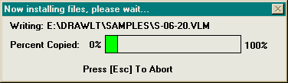
5: Provide feedback
Multiple files being copied, but feedback is file by file.
Drawing Board LT

Slide 24
5. Provide feedback
Without feedback…how long until a user gives up (start clicking randomly, gets frustrated, etc.) on average?

Slide 25
5. Provide feedback
Response time
how users perceive delays
<0.1s perceived as “instantaneous”
1s user’s flow of thought stays uninterrupted, but delay noticed
10s limit for keeping user’s attention focused on the dialog
> 10s user will want to perform other tasks while waiting

Slide 26
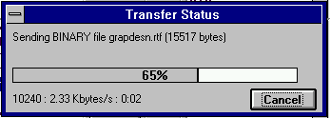
5. Provide feedback
Dealing with long delays
Cursors
for short transactions
Percent done dialogs
time left
estimated time
Random
for unknown times
Contacting host (10-60 seconds)
cancel

Slide 27
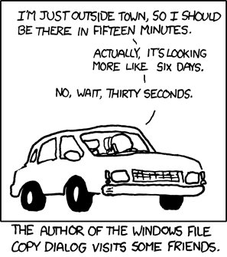
5. Provide Feedback
Xkcd.com/612

Slide 28
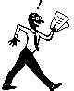
6. Provide clearly marked exits
Users don’t like to feel trapped by the computer!
should offer an easy way out of as many situations as possible
Strategies:
Cancel button (for dialogs waiting for user input)
Universal Undo (can get back to previous state)
Interrupt (especially for lengthy operations)
Quit (for leaving the program at any time)
Defaults (for restoring a property sheet)
Core
Dump

Slide 29
7. Provide shortcuts
Experienced users - perform frequent operations quickly
Strategies:
keyboard and mouse accelerators
abbreviations
command completion
context menus
function keys
double clicking vs menu selection
type-ahead (entering input before the system is ready for it)
navigation jumps
e.g., going to window/location directly, and avoiding intermediate nodes
history systems
WWW: ~60% of pages are revisits

Slide 30
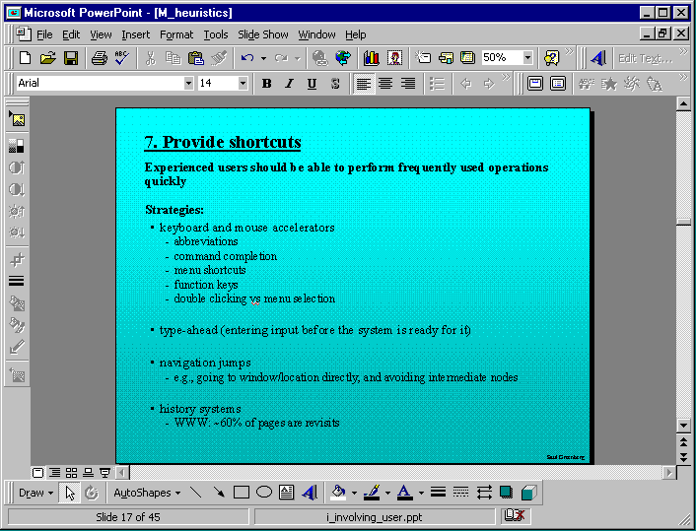
Keyboard accelerators for menus
Customizable toolbars and palettes for frequent actions
Split menu, with recently used fonts on top
Double-click raises toolbar dialog box
Double-click raises object-specific menu
Scrolling controls for page-sized increments
Microsoft Powerpoint

Slide 31
8: Deal with errors in a positive manner
People will make errors!
Errors we make
Mistakes
conscious deliberations lead to an error instead of correct solution
Slips
unconscious behaviour gets misdirected en route to satisfying goal
e.g. drive to store, end up in the office
shows up frequently in skilled behaviour
usually due to inattention
often arises from similar actions

Slide 32
Designing for slips
General rules
prevent slips before they occur
detect and correct slips when they do occur
user correction through feedback and undo

Slide 33
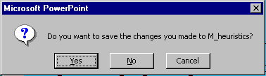
Types of slips
Capture error
frequently done activity takes charge instead of one intended
occurs when common & rarer actions have same initial sequence
change clothes for dinner and find oneself in bed (William James, 1890)
confirm saving of a file when you don’t want to delete it
minimize by
make actions undoable instead of confirmation
allows reconsideration of action by user
e.g. open trash to undelete a file
I can’t believe I pressed Yes...

Slide 34
Types of slips
Description error
intended action similar to others that are possible
usually occurs when right & wrong objects physically near each other
pour juice into bowl instead of glass
throw sweaty shirt in toilet instead of laundry basket
move file to wrong folder with similar name
minimize by
rich feedback
check for reasonable input, etc.
undo

Slide 35
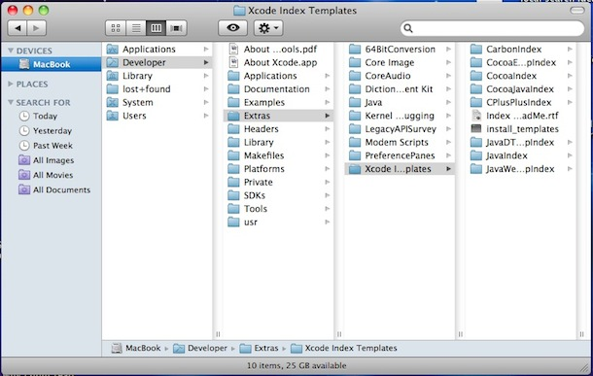
Types of slips
Loss of activation
forget what the goal is while undergoing the sequence of actions
start going to room and forget why you are going there
navigating menus/dialogs & can’t remember what you are looking for
but continue action to remember (or go back to beginning)!
minimize by
if system knows goal
make it explicit
allow user to see path taken

Slide 36
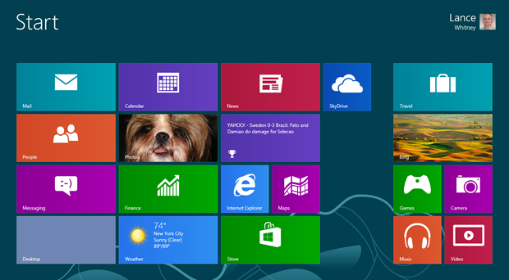
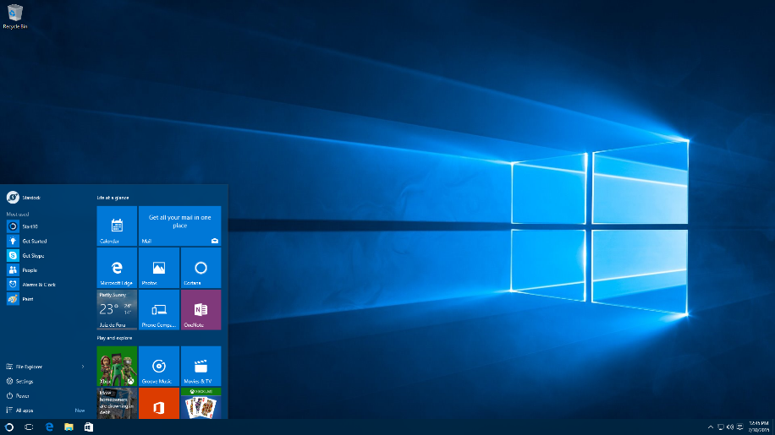
Types of slips
Mode errors
people do actions in one mode thinking they are in another
refer to file that’s in a different directory
look for commands / menu options that are not relevant
minimize by
have as few modes as possible (preferably none)
make modes highly visible

Slide 37
Generic system responses for errors
General idea: Forcing functions
prevent / mitigate continuation of wrongful action
Gag
deals with errors by preventing the user from continuing
eg cannot get past login screen until correct password entered
Warn
warn people that an unusual situation is occurring
when overused, becomes an irritant
e.g.,
audible bell
alert box

Slide 38
Generic system responses for errors
Do nothing
illegal action just doesn’t do anything
user must infer what happened
enter letter into a numeric-only field (key clicks ignored)
put a file icon on top of another file icon (returns it to original position)
Self-correct
system guesses legal action and does it instead
but leads to a problem of trust
spelling corrector

Slide 39
Generic system responses for errors
Lets talk about it
system initiates dialog with user to come up with solution to the problem
compile error brings up offending line in source code
Teach me
system asks user what the action was supposed to have meant
action then becomes a legal one

Slide 40
Movies / Some fun stuff
https://www.designernews.co/stories/84443-redditors-design-worst-volume-sliders-possible
https://m.reddit.com/r/videos/comments/34mazb/speechtotext_scripting_how_long_can_you_watch_him/

Slide 41
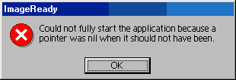
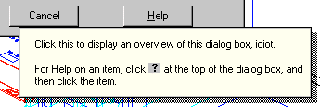
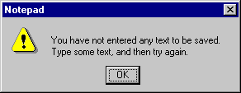
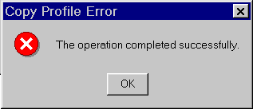
8: Deal with errors in a positive manner
Adobe's ImageReady
AutoCAD Mechanical
Windows Notepad
Microsoft's NT Operating System

Slide 42
8: Deal with errors in a positive manner
Provide meaningful error messages
error messages should be in the user’s task language
don’t make people feel stupid
Try again, bonehead!
Error 25
Cannot open this document
Cannot open “chapter 5” because the application “Microsoft Word” is not on your system
Cannot open “chapter 5” because the application “Microsoft Word” is not on your system. Open it with “Teachtext” instead?

Slide 43
8: Deal with errors in a positive manner
Prevent errors
try to make errors impossible
modern widgets: can only enter legal data
Provide reasonableness checks on input data
on entering order for office supplies
5000 pencils is an unusually large order. Do you really want to order that many?

Slide 44
9. Provide help
Help is not a replacement for bad design!
Simple systems:
walk up and use; minimal instructions
Most other systems
feature rich
simple things should be simple
learning path for advanced features
Volume 37:
A user's
guide to...

Slide 45
Documentation and how it is used
Many users do not read manuals
prefer to spend their time pursuing their task
Usually used when users are in some kind of panic
paper manuals unavailable in many businesses!
e.g. single copy locked away in system administrator’s office
online documentation better
good search/lookup tools
online help specific to current context
Sometimes used for quick reference
syntax of actions, possibilities...
list of shortcuts ...

Slide 46
Types of help
Tutorial and/or getting started manuals
short guides that people are likely to read when first obtaining their systems
encourages exploration and getting to know the system
tries to get conceptual material across and essential syntax
on-line “tours”, exercises, and demos
demonstrates very basic principles through working examples

Slide 47
Types of help
Staggered Tutorials!
- If you MUST tutorialize features, DO NOT overwhelm your users!
Guidelines:
Use short tutorials.
Minimize text that must be read.
Stagger tutorial (show only feature user needs to learn at that moment).

Slide 48
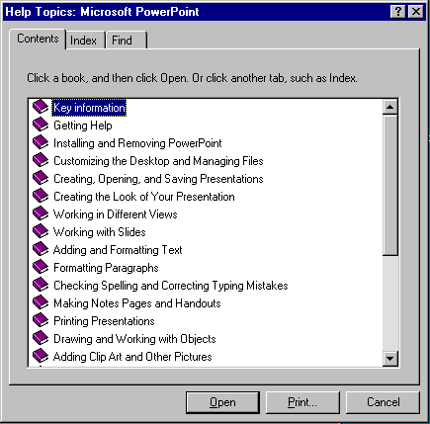
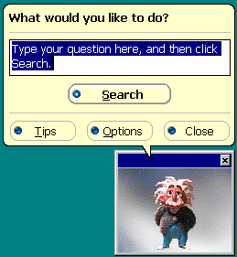
Types of help
Reference manuals
used mostly for detailed lookup by experts
rarely introduces concepts
thematically arranged
on-line hypertext
search / find
table of contents
index
cross-index
Microsoft Help

Slide 49
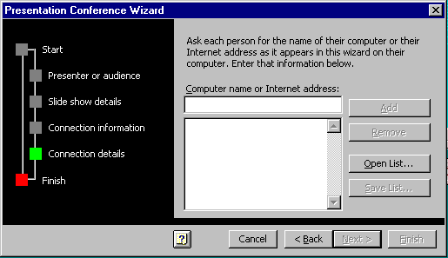
Types of help
Wizards
walks user through typical tasks
but dangerous if user gets stuck
What’s my computer’s name? Fred? Intel? AST?
Microsoft Powerpoint

Slide 50
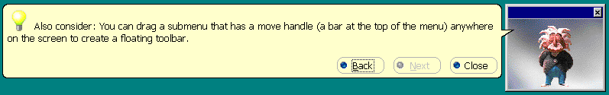
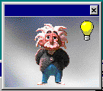
Types of help
Tips
migration path to learning system features
also context-specific tips on being more efficient
must be “smart”, otherwise boring and tedious
Microsoft Word

Slide 51
You know now
Nine principles of design
Simple and natural dialog
Speak the user’s language
Minimize user’s memory load
Be consistent
Provide feedback
Provide clearly marked exits
Provide shortcuts
Deal with errors in a positive manner
Provide help

